Slide 1
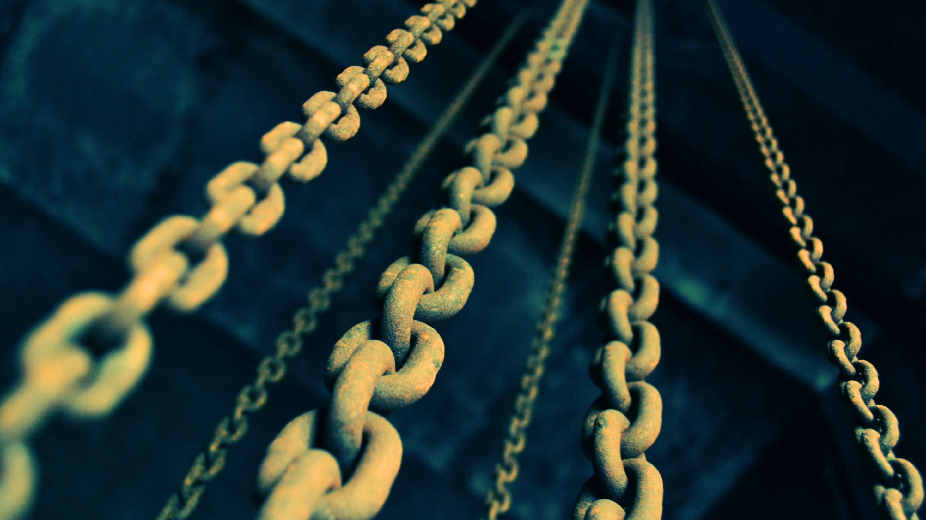

Blockchain & Distributed Ledgers
Cork Blockchain #1, 2018-05-01
Johannes Ahlmann, CTO @ Claru
Claru
Claru.io

Slide 2

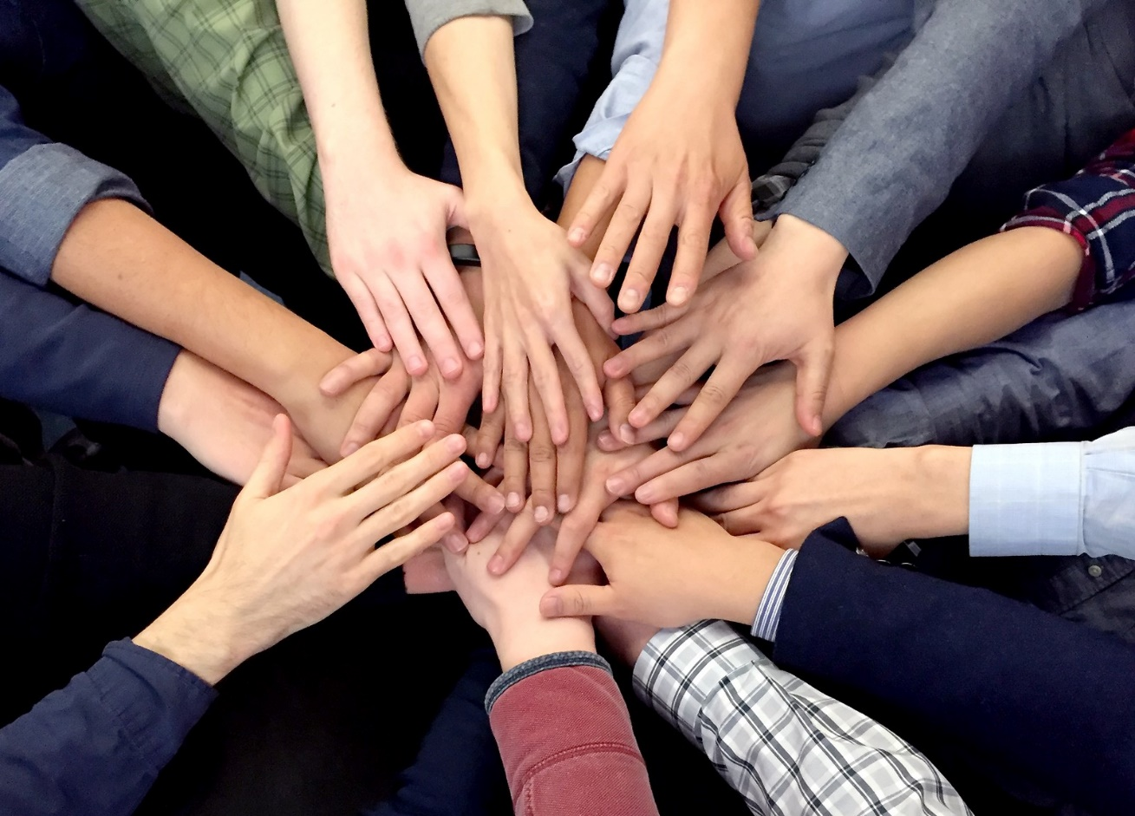
Agenda
1) High-Level Overview
2) Meetup Consensus
images:
https://www.biggerpockets.com/renewsblog/2014/07/18/high-level-overview-literally-30-unique-real-estate-markets-around-world/
https://medium.com/@bitcoinroundtable/bitcoin-roundtable-consensus-266d475a61ff

Slide 3
blockchain
crypto-currencies
digital assets
distributed ledger technology
democra-tization
fintech
legal
speculation
environ-mental
crypto-graphy
crypto-anarchy
disinter-mediation
Different Views
on Blockchain

Slide 4

1) High Level Overview
images:
https://www.biggerpockets.com/renewsblog/2014/07/18/high-level-overview-literally-30-unique-real-estate-markets-around-world/

Slide 5

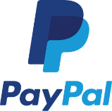




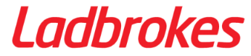
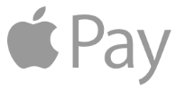
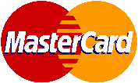
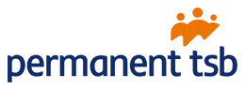
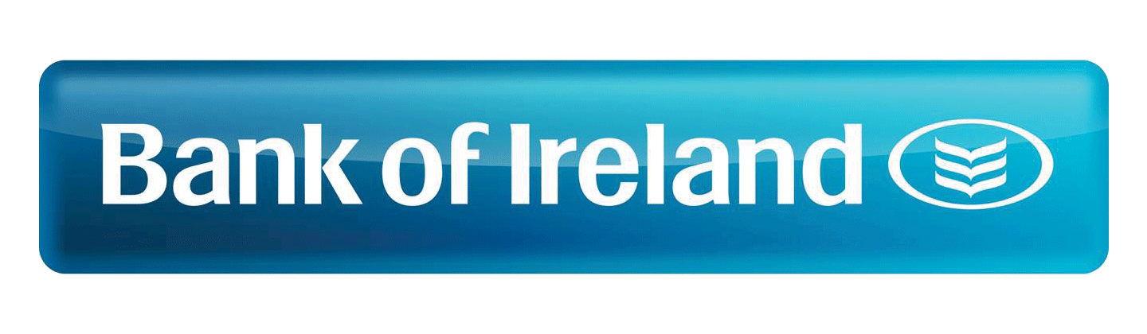





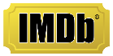


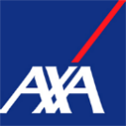

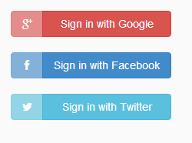







When we interact/transact with others, we often delegate Trust to Intermediaries
producer,
provider,
seller,
lender
consumer,
recipient,
buyer,
borrower

Slide 6
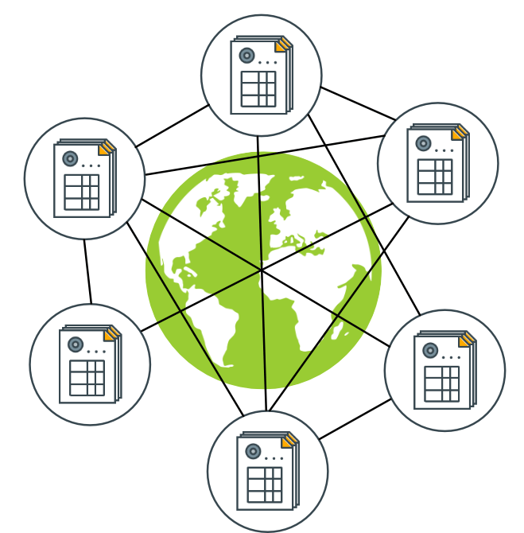
If we had a trusted Shared Ledger many of those Intermediaries would no longer be necessary
Shared, distributed Ledger
Immediate Consensus on "State of the World"
Tamper-Proof
Public, anyone can access, validate
Transactions change the state
sources:
https://commons.wikimedia.org/wiki/File:Server-based-network.svg
http://www.gjermundbjaanes.com/img/posts/distributed_ledger.png

Slide 7
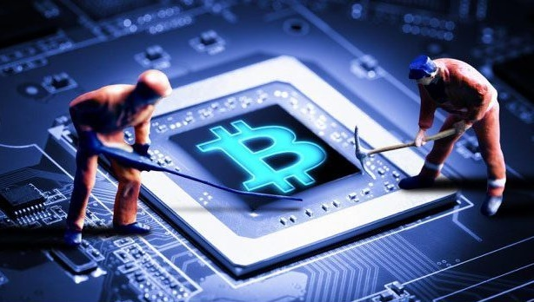
How can we achieve a shared, trusted Ledger without Trust between Parties?
Block = List of Transactions
Blockchain = Chain of Blocks
Tamper-Proof
Consensus (PoW)
Miners expend energy to find hash puzzle solution
Other nodes accept block if it is valid
Trustless
Nodes assumed to be untrusted
Fair Lottery, Cryptography ensure that no one can cheat
prev: H( )
prev: H( )
prev: H( )
tx
tx
tx
tx
tx
tx
tx
tx
tx
tx
tx
tx
tx
tx
tx
source: https://medium.com/@brettking/abc61b2ab49a

Slide 8
A Consortium Blockchain can address some Challenges Companies may find with Public Blockchains
Public | Consortium
Data is Public | Privacy, Confidentiality
Transactions are Public | Private Channels
Pseudonymous | Known participants
Anyone can join | Permissioned
Anyone can access | Permissioned
Trustless Nodes | Semi-Trusted Nodes
Low tx/s | High tx/s
 | GDPR Compliance
Group of known, semi-trusted parties
Access granted by members
Consensus ~ majority vote (BFT)
Consensus can withstand 1/3 of malicious nodes
Easier Governance

Slide 9
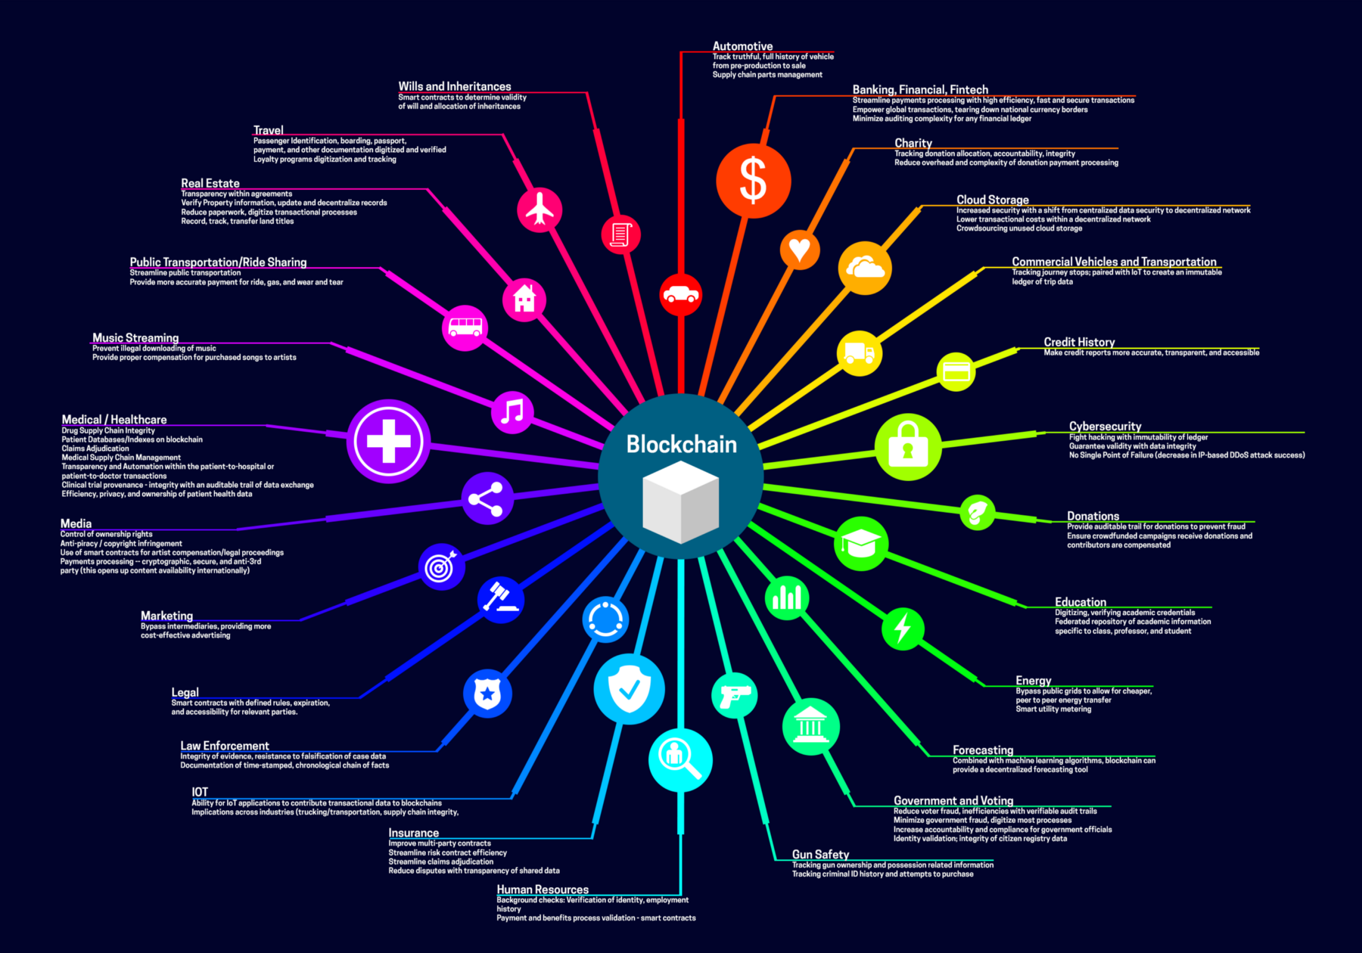
What are some of the Blockchain Use Cases for Companies?
Data Exchange between multiple parties
End-to-End Supply Chain Transparency
Product Traceability
Marketplaces, Trading
Clearance & Settlement
Public Registries
source: https://medium.com/fluree/blockchain-for-2618-and-beyond-a-growing-list-of-blockchain-use-cases-37db7c19fb99

Slide 10
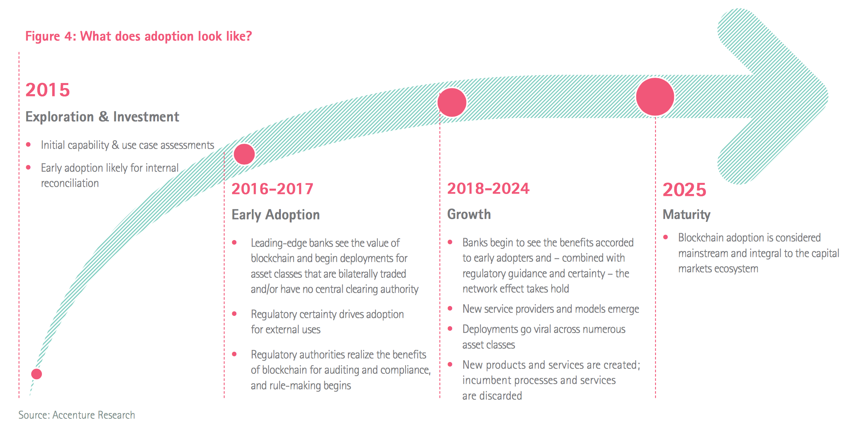
There is large interest in Blockchain Adoption, with many projects underway
Maersk | cargo tracking
Port of Antwerp | container handling
Walmart | supply chain transparency
Airbus | jet plane parts tracking
UPS | supply chain transparency
FedEx | customer dispute resolution
Australian Securities Exchange | clearance & settlement
Credit Suisse | syndicated loans
Dubai Land Dept. | land registry

Slide 11
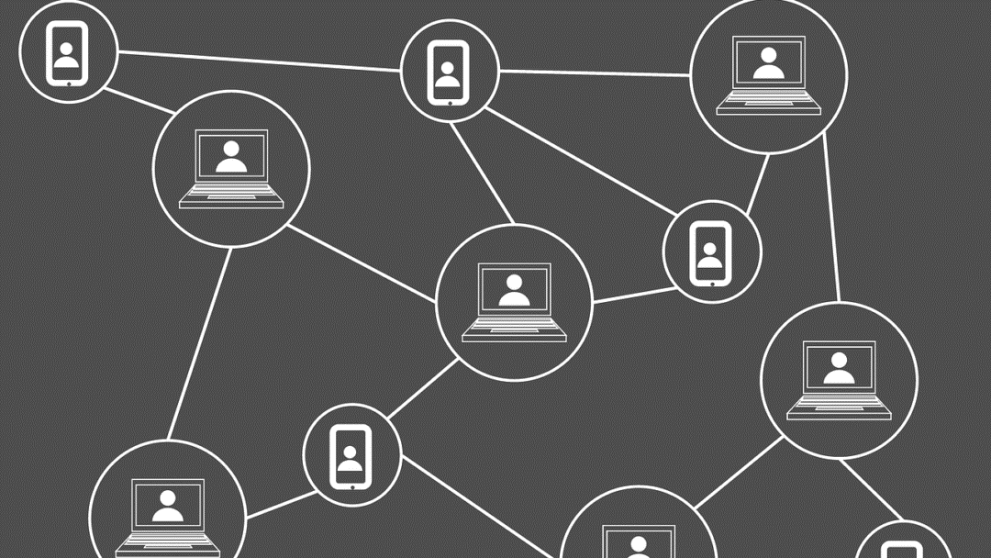
Consortium Blockchains
images:
http://contractize.com/blockchain-public-private/

Slide 12
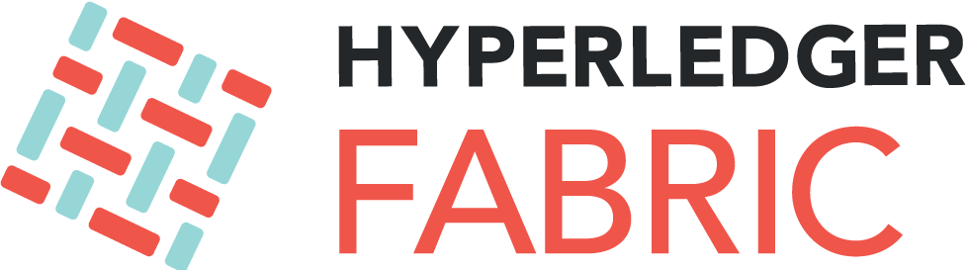
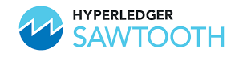
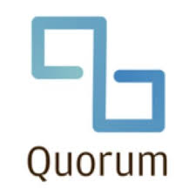
Consortium Blockchains
Hyperledger
Linux Foundation, Open Source
Fabric (IBM)
Kafka orderer, key-value store
Go, Java
Federated Channels, Private transactions
Sawtooth (Intel)
larger networks, PoET
transaction families
Burrow (Monax)
Ethereum fork
Tendermint BFT
Composer
Quorum (JP Morgan Chase)
RAFT, Istanbul BFT
Ethereum fork
Privacy, Confidentiality

Slide 13
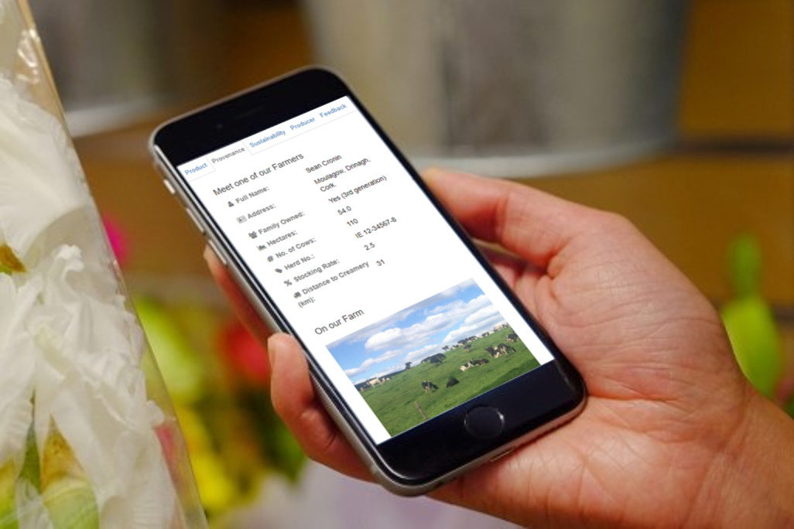
Shameless Plug:
Clárú is bringing Traceability to the Irish Dairy Sector
Claru
Claru.io
Notes:
Johannes

Slide 14
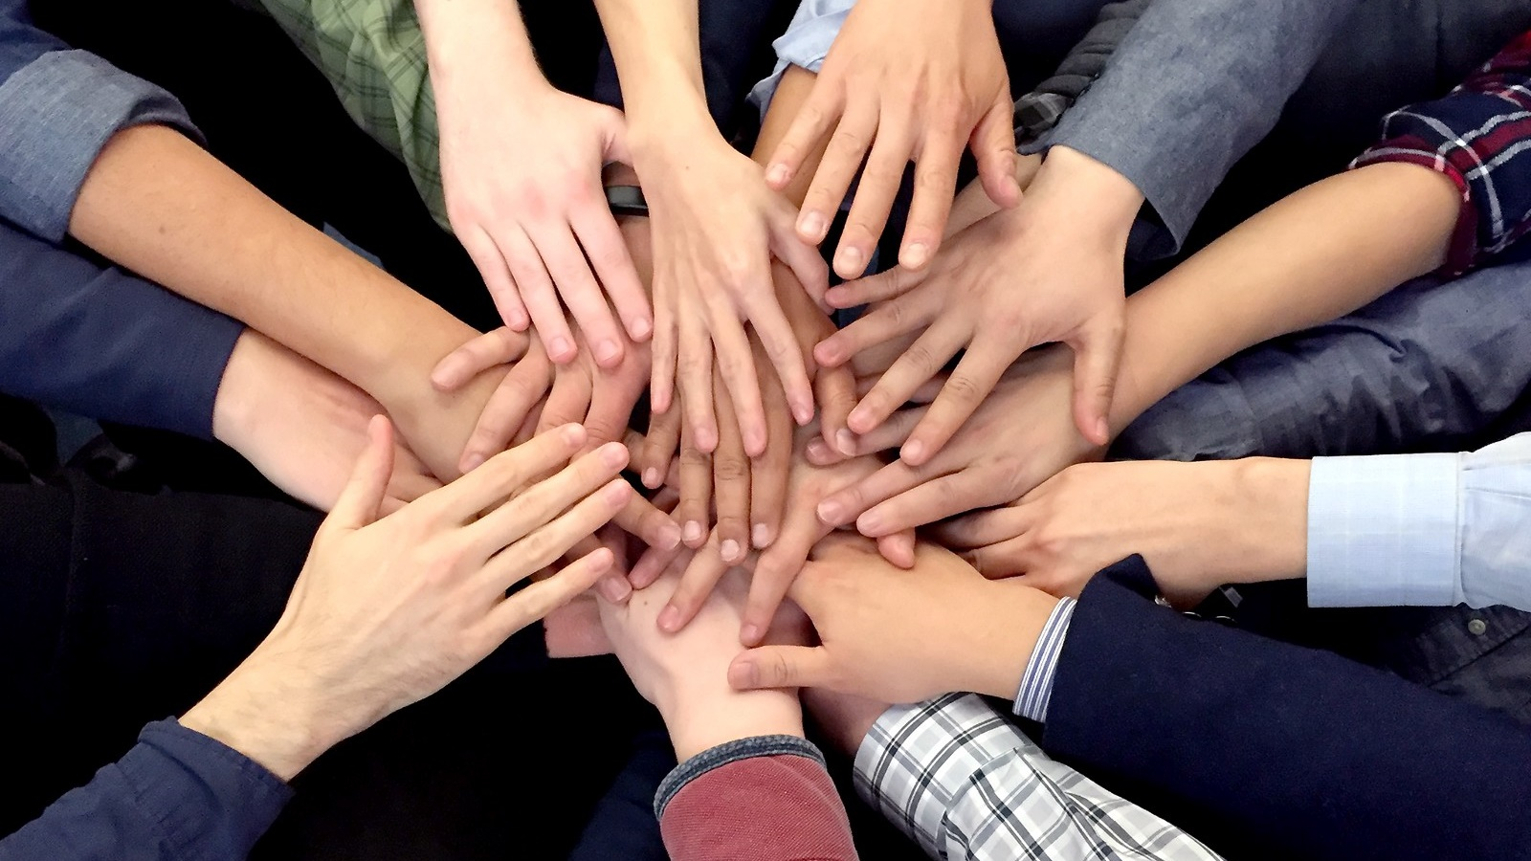
2) Meetup Consensus
images:
https://medium.com/@bitcoinroundtable/bitcoin-roundtable-consensus-266d475a61ff

Slide 15
artefacts
node
consensus rules, incentive
transaction
mining, minting
smart contract
ledger
state of the world
secret, public keys
p2p network
block
Blockchain Artefacts

Slide 16
Blockchain Properties
properties
throughput (tx/s)
fault
tolerance
privacy, confiden-tiallity
trusted, trustless
permission-less
verifiable, transparent
consensus scope
sybil,
double spend
tamper-resistant
anonymous, pseudo-nimous
censorship-resistant

Slide 17
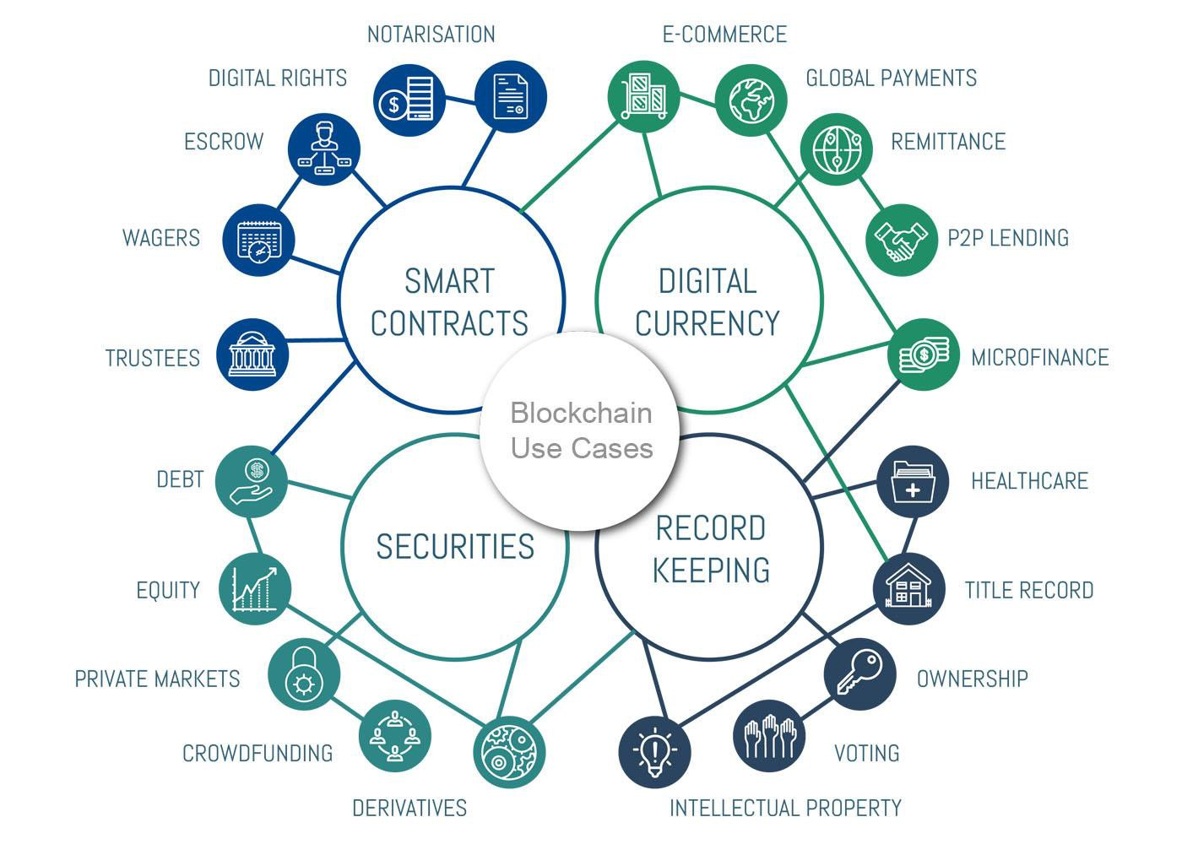
Blockchain Use Cases
https://medium.com/@sergiomarrero/6-emerging-categories-for-blockchain-use-cases-4650f824d130

Slide 18
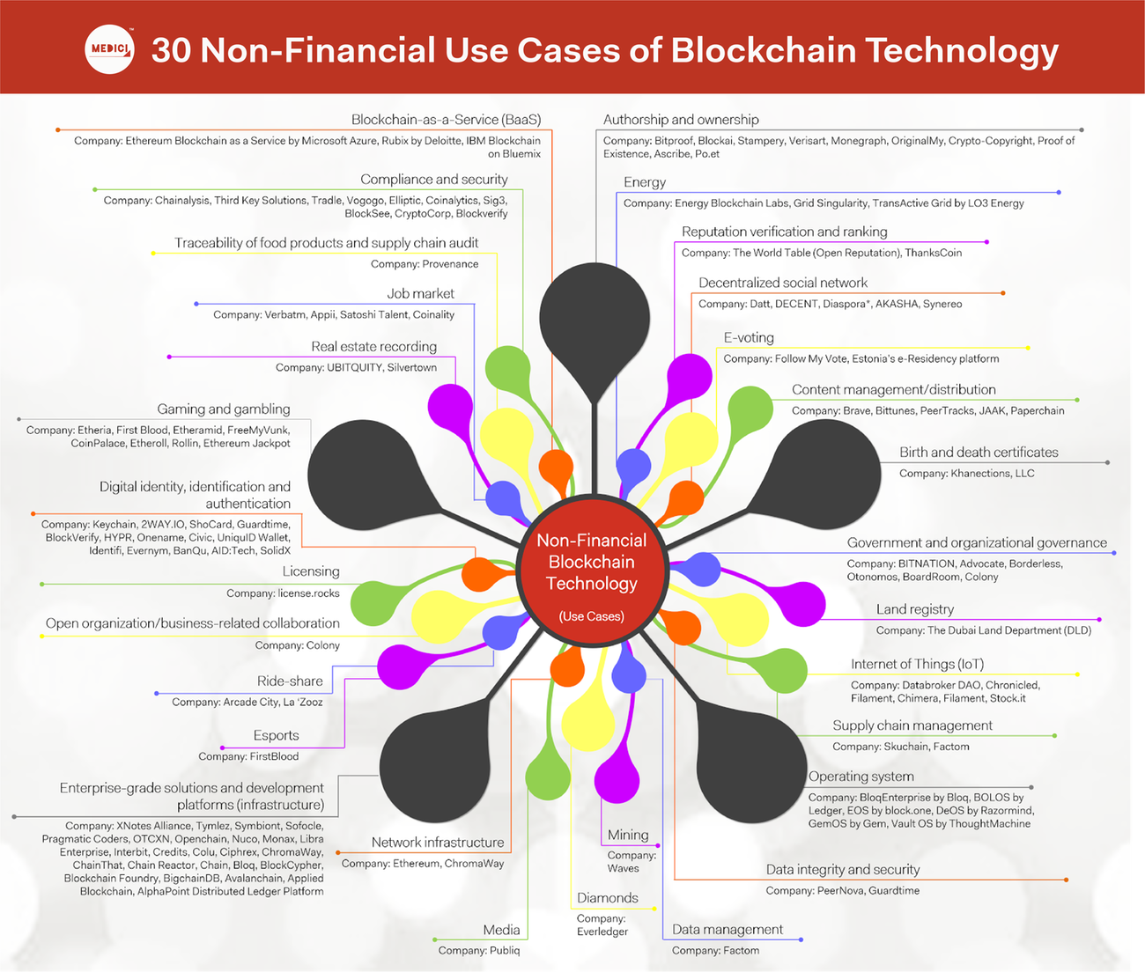
https://gomedici.com/30-non-financial-use-cases-of-blockchain-technology-infographic/

Slide 19
Do you want to know more?
Meetup: Cork Blockchain
Slides, Material on corkblockchain.com
Upcoming "Blockchain in Practice" Event at UCC, date TBD => claru.io
Good MOOCs
Coursera (Bitcoin and Cryptocurrency Technologies)
University of Nicosia (DFIN-511 Introduction to Digital Currencies)
Also offer MSc Digital Currencies

Slide 20
Thank you, any questions?
Claru
Claru.io

